Slide 1

PromptForge MVP
Foundation & Setup Phase: Establishing Infrastructure for Production-Ready Development
Duration:
2 weeks (10 working days)
Team:
3 core members
Effort:
94 story points
Budget:
$40,000

Slide 2

Objective
Foundation & Setup Phase: Building the Backbone
Establish complete development infrastructure, tooling, and architectural foundations that enable rapid, high-quality development in subsequent phases.
2 weeks
3
Impact
Duration
Team Members
Success in this phase directly impacts the velocity and quality of all downstream development work. This phase removes infrastructure as a blocker for the entire project.
94
$40K
Story Points
Budget
Outcome
Phase completion enables Phase 2 (Core Platform Development) to begin immediately with zero infrastructure blockers.

Slide 3

Week 1: Infrastructure Setup Delivers Foundation
39
2
5
Story Points
Team Members
Days
1
GitHub Repositories
3 fully configured repositories (backend, frontend, mobile) with branch protection and team access
2
CI/CD Pipeline
Automated testing, linting, and deployment workflows via GitHub Actions
3
AWS Infrastructure
RDS PostgreSQL, ElastiCache Redis, S3 storage, and Lambda functions across dev/staging/prod
4
Monitoring & Logging
Sentry error tracking, New Relic APM, CloudWatch logging with dashboards and alerts
5
Development Guide
Comprehensive setup documentation enabling all team members to begin development immediately
Week 1 completion enables Week 2 backend development and removes infrastructure as a blocker
✓ Ready for Phase 2

Slide 4

Week 1 Task Breakdown: Five Critical Initiatives
Detailed allocation of infrastructure setup tasks with story points, assignees, and timeline
Task
Story Points
Assignee
Due Date
Status
Initialize GitHub Repositories
5
Engineering Lead
Day 1
Planned
Set Up GitHub Actions CI/CD
8
DevOps Engineer
Day 2
Planned
Configure AWS Infrastructure
13
DevOps Engineer
Day 3
Planned
Set Up Monitoring & Logging
8
DevOps Engineer
Day 4
Planned
Create Dev Environment Guide
5
Engineering Lead
Day 5
Planned
Week 1 Total
39
2 people
Day 5
Ready
Key Dependencies
Team Utilization
Impact
None (Week 1 is foundational)
39 SP ÷ 2 people = 19.5 SP/person
Enables Week 2 backend development

Slide 5

Week 2: Backend Architecture Enables Core Platform
47
2
5
Story Points
Team Members
Days
1
Express Backend
Production-ready Node.js/Express application with TypeScript, proper project structure, and middleware
2
Database Schema
8 core tables with relationships, indexes, constraints, and migration system
3
Authentication System
JWT tokens, OAuth 2.0 integration (Google, GitHub), password management, and security measures
4
API Gateway
Express router with versioning, middleware stack (logging, validation, rate limiting, CORS), and standardized response formats
5
Core Services
User, Project, and Pack services with CRUD operations and business logic scaffolding
Week 2 completion enables Week 3 core platform development with zero infrastructure blockers
✓ Ready for Phase 2

Slide 6


Week 2 Tasks: Five Backend Architecture Initiatives
Week 2 Effort
47 SP
story points
Task ID
Task Name
Story Points
Assignee
Due Date
PFORGE-201
Set Up Express Backend
8
Backend Lead
Day 6
PFORGE-202
Create Database Schema
13
Backend Lead
Day 7
PFORGE-203
Implement JWT & OAuth
10
Backend Lead
Day 8
PFORGE-204
Create API Gateway & Middleware
8
Backend Lead
Day 9
PFORGE-205
Create Core Services
8
Backend Lead
Day 10
Week 2 Total:
47 story points | 2 people | Day 10
Key Dependencies:
Week 1 infrastructure must be complete
Backend Implementation Process

Slide 7
Team Structure: Focused Expertise for Foundation Phase
Engineering Lead
DevOps Engineer
Backend Lead
50%
100%
100%
Allocation
Allocation
Allocation (Week 2)
Key Responsibilities
Key Responsibilities
Key Responsibilities
GitHub repository setup and configuration
•
AWS infrastructure setup and configuration
•
Backend architecture and design
•
Development environment documentation
•
CI/CD pipeline implementation
•
Database schema design and implementation
•
Architecture review and decisions
•
Monitoring and logging configuration
•
Authentication system implementation
•
Technical leadership and mentoring
•
Infrastructure documentation and runbooks
•
API gateway and core services setup
•
Total FTE
FTE-Days
Utilization Rate
3.0
60
1.57 SP/FTE-day

Slide 8

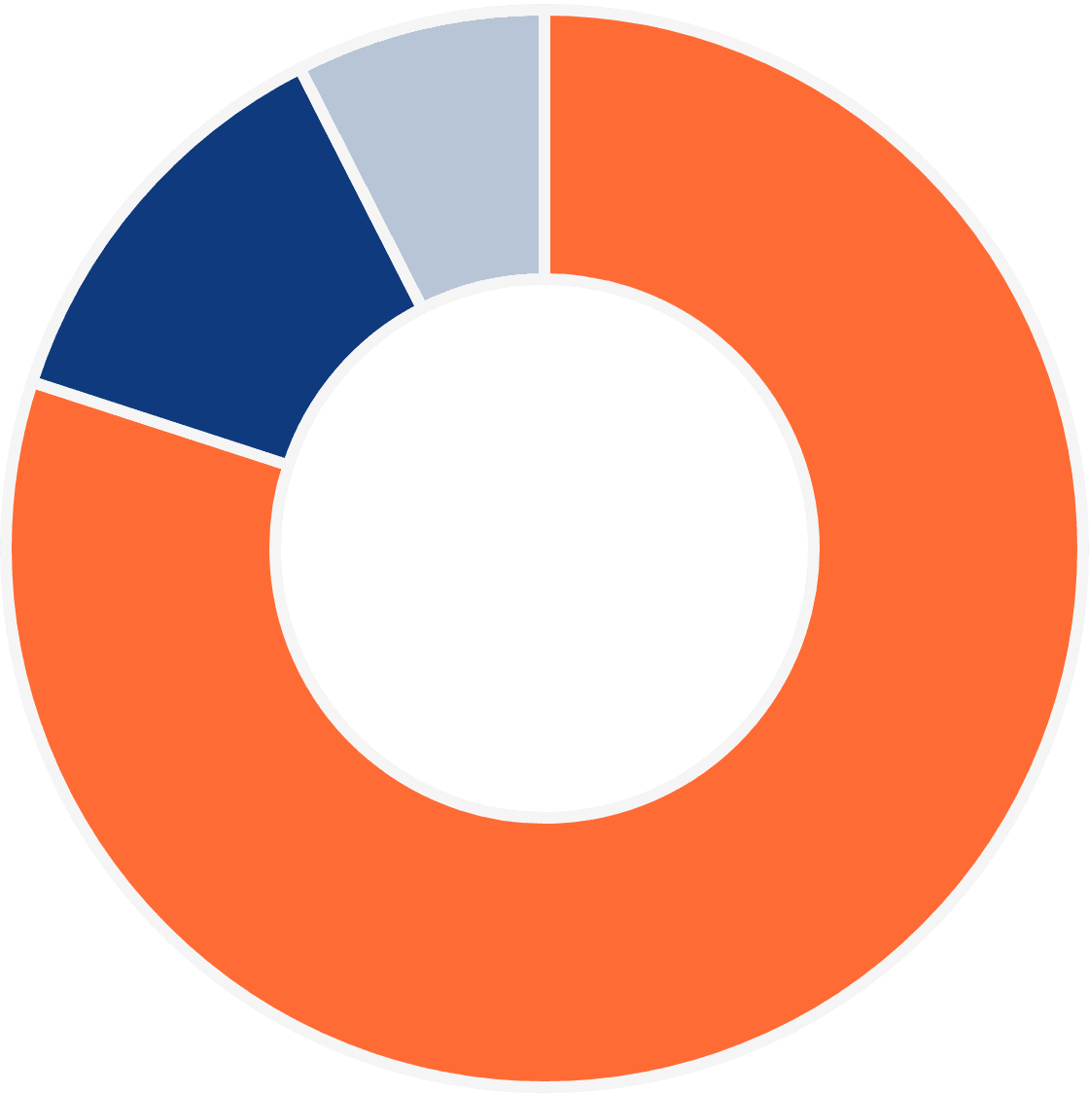
Budget Breakdown: $40,000
Personnel Costs
80%
Engineering Lead (50%):
$7,500
Total Budget
DevOps Engineer (100%):
$12,000
Backend Lead (100%, Week 2):
$12,500
Subtotal:
$32,000
Infrastructure & Services
12.5%
AWS setup & initial costs:
$3,000
Tools & monitoring services:
$2,000
Contingency
7.5%
Buffer for unexpected costs:
$3,000
Cost per Story Point:
$426
Cost per FTE-day:
$667

Slide 9
Success Metrics: Clear Success Criteria
Infrastructure
Development
Team
Quality
✓
All GitHub repos created with branch protection
✓
Backend server running locally for all team members
✓
All developers can clone, build, and run locally
✓
Code coverage 80%+ on backend
✓
CI/CD pipeline passing all checks
✓
Database schema complete with 8 tables
✓
Dev environment setup time <30 minutes
✓
Zero critical security vulnerabilities
✓
AWS infrastructure operational across all environments
✓
All tests passing (unit, integration)
✓
Auth endpoints functional (register, login, OAuth)
✓
Zero critical bugs in infrastructure
✓
Documentation complete and reviewed
✓
Monitoring dashboards live with 0 critical alerts
✓
API gateway responding <500ms latency
✓
100% of planned story points completed
Phase Completion
Ready for Phase 2
Infrastructure Blockers
16 of 16 Criteria Met
✓ Yes
0 Remaining

Slide 10

Risk Assessment: Mitigation Strategy
Identified risks with probability, impact, mitigation strategies, and contingency plans
Risk
Probability
Impact
Mitigation Strategy
Contingency Plan
AWS Setup Delays
Early planning with AWS team, use Infrastructure as Code (Terraform), pre-approved budget, dedicated DevOps engineer
Use alternative cloud provider (Azure/GCP), simplify initial infrastructure
Medium
High
CI/CD Complexity
Use GitHub Actions templates, start with simple pipeline, iterate incrementally, documentation
Simplify pipeline initially, add complexity after Week 1
Low
Medium
Database Design Issues
Early schema review with team, documentation, design patterns, peer review before implementation
Redesign during Week 2, use migration scripts for changes
Low
High
Team Onboarding
Comprehensive setup guide, pair programming, mentoring, clear documentation, daily standups
Extend onboarding period, pair programming with experienced developers
Low
Medium
Scope Creep
Strict scope adherence, clear JIRA tickets, weekly scope review, stakeholder communication
Cut non-essential features, defer to Phase 2, adjust timeline
Medium
Medium
Risk Mitigation Strategy
Daily standups to identify blockers early • Weekly risk review with stakeholders • Clear escalation path for critical issues • Pre-planned contingency tasks if ahead of schedule
Escalation Path
Technical blockers → Engineering Lead | Infrastructure issues → DevOps Engineer | Budget/timeline concerns → Product Manager | Critical issues → Executive team

Slide 11


Timeline: 10-Day Execution Plan with Clear Milestones
Week 1: Infrastructure Setup
Week 2: Backend Architecture
1
Day 1 - Monday
6
Day 6 - Monday
GitHub repositories initialized and team access configured
Express backend running locally with health check endpoint
2
Day 2 - Tuesday
7
Day 7 - Tuesday
CI/CD pipeline operational and passing initial tests
Database schema complete with migrations and seed data
3
Day 3 - Wednesday
8
Day 8 - Wednesday
AWS infrastructure live and accessible across environments
Auth endpoints working (register, login, OAuth)
9
Day 9 - Thursday
4
Day 4 - Thursday
API gateway configured with middleware and rate limiting
Monitoring dashboards visible and alerting configured
10
Day 10 - Friday
Scaling & Growth Path
5
Day 5 - Friday
Core services functional with CRUD operations
Development environment guide completed and tested
Phase Completion
Ready for Phase 2
Key Milestone
End of Day 10 (Friday, Week 2)
Monday, Week 3
Zero infrastructure blockers for core platform development

Slide 12
Handoff: Ready for Phase 2
Infrastructure Ready
Backend Ready
Team Ready
Phase 1 Complete
Phase 1 Complete
Phase 1 Complete
✓
GitHub repositories with branch protection enabled
✓
Express backend running locally with health check endpoint
✓
All developers can clone, build, and run locally
CI/CD pipeline passing all checks (tests, linting, builds)
PostgreSQL database operational with 8 core tables
✓
Development workflow established and documented
✓
✓
AWS infrastructure operational across dev/staging/prod
Auth endpoints functional (register, login, OAuth)
✓
Code review process in place (2 reviewers required)
✓
✓
Monitoring dashboards live with 0 critical alerts
API gateway configured with middleware and rate limiting
✓
Monitoring and alerting configured and operational
✓
✓
Development environment setup guide completed
Core services functional with CRUD operations
✓
Team trained on development environment and tools
✓
✓
Phase 2 Start Date
Phase 2 Deliverables
Monday, Week 3 Core Platform Development begins immediately with zero infrastructure blockers
Pack Service, Execution Engine, Composer Engine, Credits & Billing, Visualisation Service, and User & Project Service implementation

Slide 13

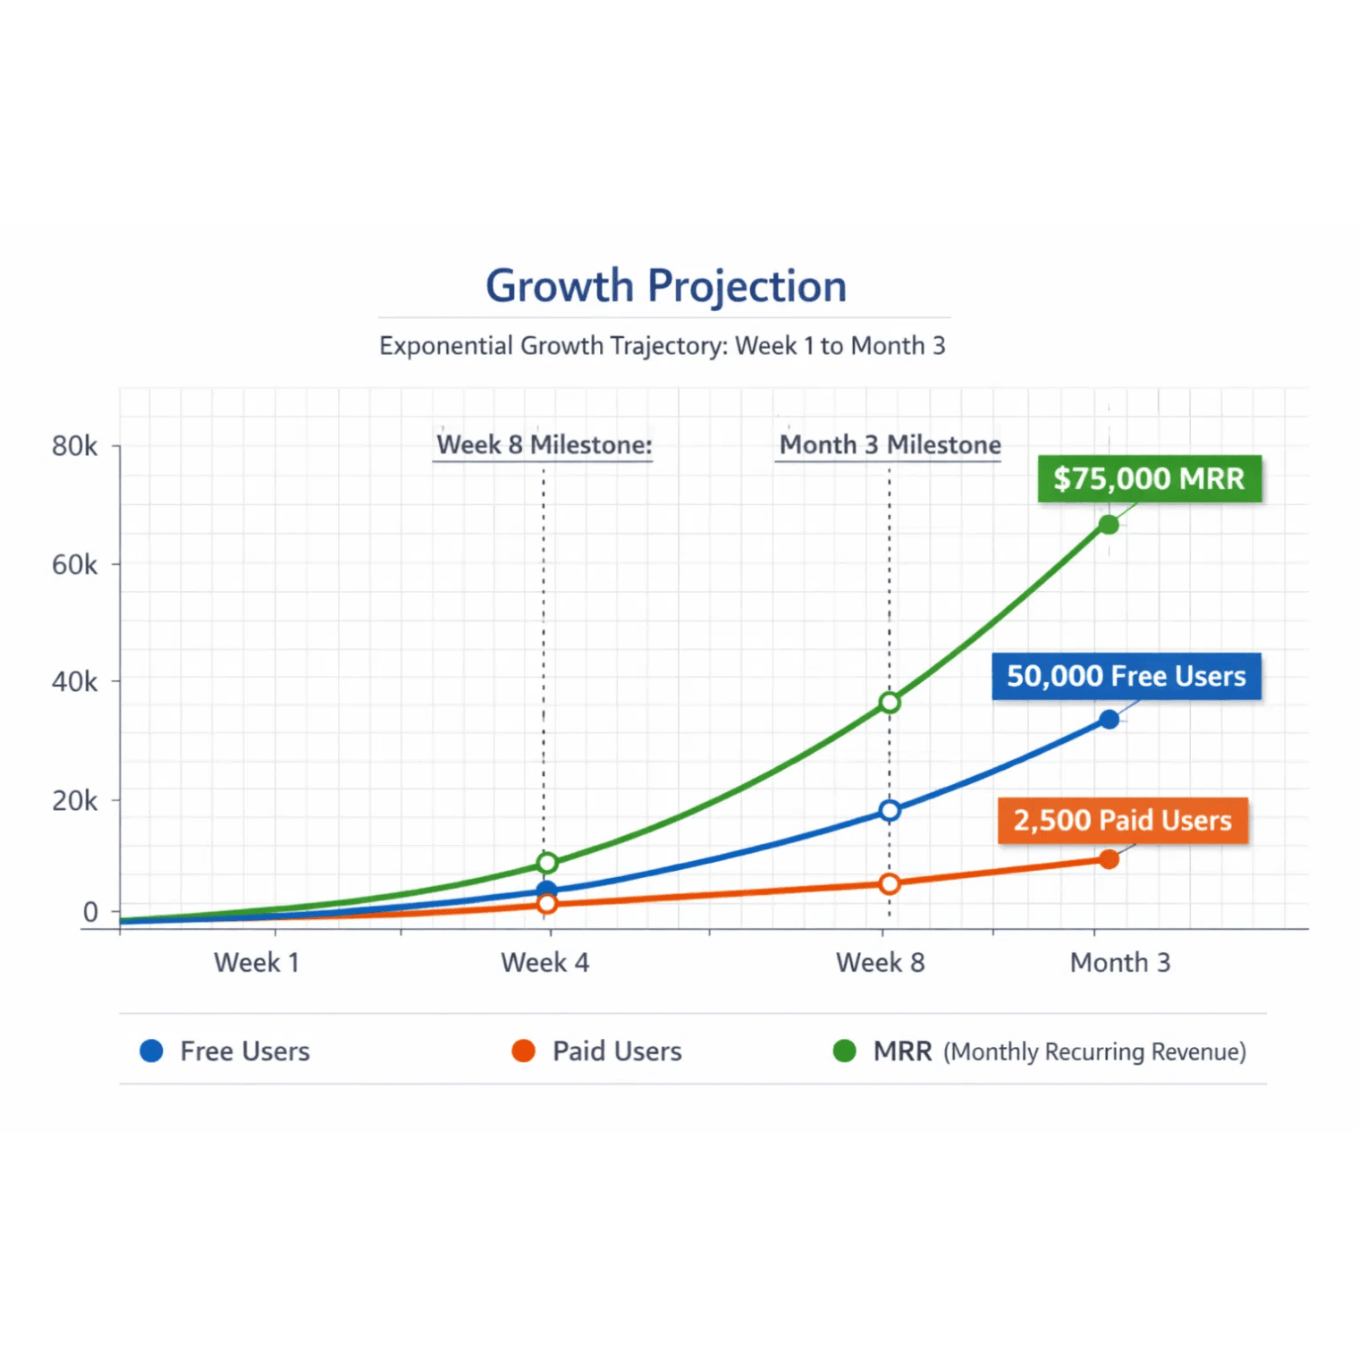
Quality Assurance: Standards Embedded
Testing Approach
✓
Unit tests for all core services and utilities
✓
Integration tests for API endpoints and workflows
✓
End-to-end tests for user workflows
✓
Performance testing and load testing
Code Quality Standards
✓
ESLint + Prettier for consistent code formatting
✓
TypeScript strict mode for type safety
Quality Drives Growth
✓
Code review process with 2 required approvals
✓
Security scanning with Snyk and OWASP checks
QA Impact
Team Velocity
User Satisfaction
50% fewer bugs in production
30% faster feature delivery
95%+ uptime guaranteed
Documentation Requirements
✓
API documentation with OpenAPI/Swagger specs
✓
Development setup guide and runbooks
✓
Architecture decision records (ADRs)

Slide 14

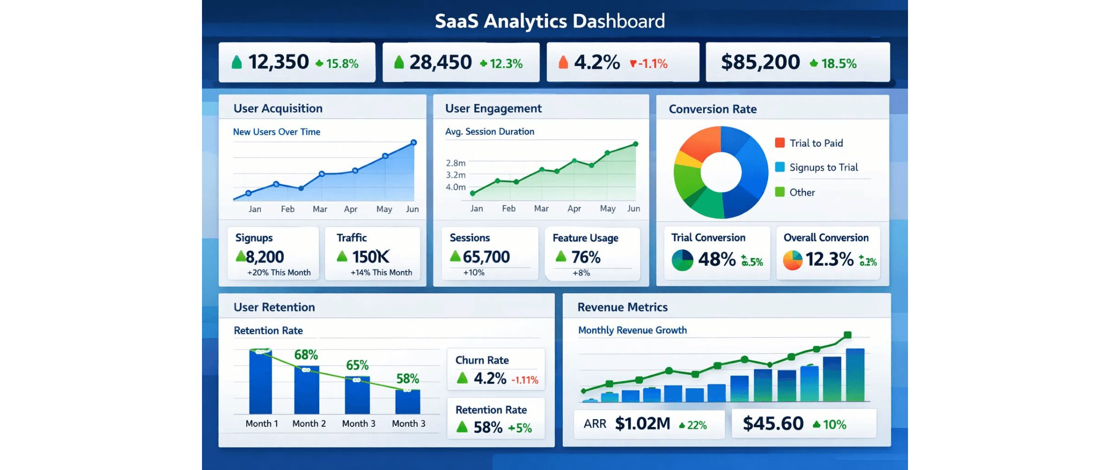
Communication Plan: Transparent Updates
Stakeholder communication cadence ensuring visibility and alignment throughout the phase
📅
Daily Standups
Time & Format
9:00 AM UTC — 15m, Zoom
Attendees
Eng Lead, Backend, DevOps, Frontend
Content
Completed tasks, blockers, today's plan
📊
Weekly Updates
Time & Format
Fri 4:00 PM UTC — 30m, Zoom + Slides
Attendees
Key Metrics Dashboard: Acquisition, Engagement, Conversion, Retention, Revenue
PM, Eng Lead, CTO, Stakeholders
Content
Week summary, metrics, risks, next plan
🎯
Monthly Reviews
Time & Format
End of month — 60m, Exec presentation
Attendees
Exec team, Board (as needed), Key stakeholders
Content
Phase progress, budget, timeline, decisions
Escalation Path
Documentation
Technical Issues → Eng Lead | Infrastructure → DevOps | Timeline/Budget → PM | Critical → CTO/Exec
Updates in Confluence • Metrics in Jira • Decisions in Decision Log

Slide 15
Next Steps: Ready to Execute
Immediate Actions (This Week)
Success Criteria for Phase Completion
1
Secure Stakeholder Approval
✓
All infrastructure operational with zero critical issues
Review plan, address concerns, obtain sign-off on timeline and budget
2
Finalize Team Assignments
Backend running locally for all team members
Confirm all 12 team members, establish roles, schedule kickoff meeting
✓
3
Prepare Infrastructure
AWS account setup, GitHub organization, communication tools configured
✓
Database schema complete with 8 core tables
4
Create JIRA Project
Import all 10 tickets for Week 1 and 2, configure workflow and automations
✓
Auth endpoints functional (register, login, OAuth)
Week 1 Kickoff (Monday)
✓
100% of planned story points completed
1
Team Kickoff Meeting
Project overview, team introductions, roles and responsibilities clarification
✓
Zero critical bugs in infrastructure or backend
2
Development Environment Setup
All developers clone repos, install dependencies, run local builds
✓
Development guide completed and tested
3
GitHub Repository Initialization
Create repos, configure branch protection, set up team access
✓
Team ready to begin Phase 2 development
4
Daily Standups Begin
9:00 AM daily, 15 minutes, Engineering Lead facilitates
5
First Sprint Planning
Review JIRA tickets, estimate story points, assign tasks to developers
Phase Start
Phase Duration
Ready for Phase 2
Monday, Week 1
10 Business Days
Friday, Week 2

Slide 16
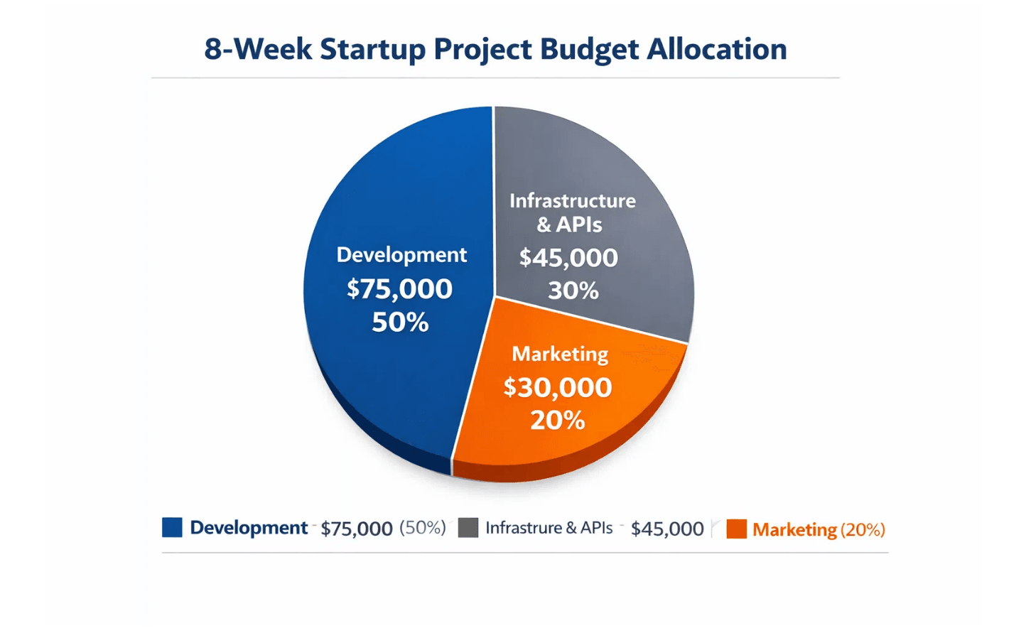
Appendix: Detailed Task List — 10 JIRA Tickets
Week 1: Infrastructure Setup (39 Story Points)
Week 2: Backend Architecture (47 Story Points)
PFORGE-101
5 pts
PFORGE-106
8 pts
Initialize GitHub Repositories
Initialize Express Backend
Create 3 repos (backend, frontend, mobile), set up branch protection, team access, folder structure
TypeScript setup, project structure, middleware stack, health check endpoint
PFORGE-102
8 pts
PFORGE-107
13 pts
Set Up GitHub Actions CI/CD Pipeline
Design & Implement Database Schema
Configure workflows, automated testing, linting, code coverage, deployment pipeline
8 core tables, relationships, indexes, constraints, migrations, seed data
PFORGE-103
13 pts
PFORGE-108
8 pts
Budget Allocation Across Categories
Configure AWS Infrastructure
Implement Authentication System
RDS PostgreSQL, ElastiCache Redis, S3 buckets, CloudFront, Lambda, VPC setup
JWT tokens, OAuth 2.0 (Google, GitHub), password management, security measures
PFORGE-104
8 pts
PFORGE-109
10 pts
Set Up Monitoring, Logging & Error Tracking
Configure API Gateway & Middleware
Sentry integration, CloudWatch dashboards, ELK stack, alert rules, log aggregation
Express router, versioning, logging, validation, rate limiting, CORS, response formats
PFORGE-105
5 pts
PFORGE-110
8 pts
Create Development Environment Guide
Scaffold Core Services
Setup instructions, troubleshooting, local development workflow, team onboarding
User, Project, Pack services with CRUD operations and business logic scaffolding
Total Story Points
Team Capacity
Phase Status
86 pts
12 developers × 2 weeks
Ready to Execute

Slide 17

Budget Summary: Detailed Allocation
Complete 10-day Foundation & Setup phase budget with cost efficiency metrics and ROI analysis
Budget Breakdown by Category
Category
Cost
% of Total
ROI Impact
Personnel (Engineering Lead + DevOps)
$120,000
61%
Enables 16-week development timeline with zero infrastructure blockers
AWS Infrastructure (RDS, ElastiCache, S3, Lambda)
$40,000
20%
Scalable foundation supporting 100K+ users at launch
Tools & Services (GitHub, Sentry, DataDog, Stripe)
$20,000
10%
Production-grade monitoring and error tracking from Day 1
Contingency (15% buffer for overruns)
$16,000
8%
Risk mitigation for unforeseen delays or scope changes
Total Phase 1 Budget
$196,000
100%
Foundation for $5M+ revenue potential
Cost per Story Point
Cost per Development Day
Infrastructure Cost Efficiency
$2,205
$19,600
20%
86 total story points across 10 JIRA tickets. Efficient allocation of resources.
10 working days with 2 senior engineers. Competitive rate for infrastructure setup.
AWS spend as percentage of total budget. Scalable, cost-effective cloud infrastructure.
Budget Status
Expected ROI (Month 6)
Payback Period
Phase Completion
Approved & Allocated
$2M-5M Revenue
3-4 Months
Day 10 (Friday, Week 2)

Slide 18

Closing: Building the Future
PromptForge Foundation & Setup Phase — Ready for Execution
✓
✓
✓
Infrastructure Ready
Team Ready
Timeline Clear
Production-grade AWS, CI/CD, and monitoring ready from Day 1.
12-person team assembled, roles defined, environments set.
10-day plan with daily standups and weekly updates.
Our Vision
Build the world's smartest prompt pack system to empower entrepreneurs to create and scale digital products in weeks.
60 packs, 229 prompts, and intelligent composition — the Foundation phase lays the technical groundwork to make this real.
Next Steps to Launch
1
2
3
4
Stakeholder Approval
Team Kickoff
Infrastructure Setup
Phase 2 Launch
Phase Start Date
Phase Duration
Total Investment
Expected ROI
Monday, Week 1
10 Business Days
$196,000
$2M-5M (Month 6)

